Slide 1

Tamil Nadu Election 2026 Analysis
Understanding Seat Flips, Vote Share, and Victory Margins
By
Chintala Mahesh Babu

Slide 2
Project Overview
Objective
To study the patterns that have occurred in the election results of Tamil Nadu 2026.
Determine key patterns in margin of victory, vote share, and political changes.
Offer insights based on statistical evidence.
Research Questions
Seat Flip Analysis: Which constituencies changed political control from 2021 to 2026?
Vote Share Analysis: How was the vote distributed among parties in 2026?
Margin Analysis: What were the closest electoral contests and their implications?

Slide 3
Dataset and Tools Used
Datasets
TN 2021 Results: Detailed election results from the 2021 Tamil Nadu assembly elections.
TN 2026 Results: Simulated/projected election results for the 2026 Tamil Nadu assembly elections.
Constituency Data: Master data providing demographic and geographical information for each constituency.
Tools & Libraries
Python: Primary programming language for data manipulation and analysis.
Pandas: Data analysis library for efficient data handling.
Matplotlib / Seaborn: Visualization libraries for creating insightful charts.
Google Colab: Cloud-based platform for collaborative coding and execution.

Slide 4
Seat Flip Analysis
"More than half of the constituencies have undergone change of political control.“
Graphic display depicting the number of seats won by the winning party (for instance, flip_counts).
Insights:
Found out that there were 143 constituencies that had undergone changes in winning parties.
Illustrates the volatility of politics in Tamil Nadu.
Shows that there have been considerable changes in voter preferences during the two elections.

Slide 5
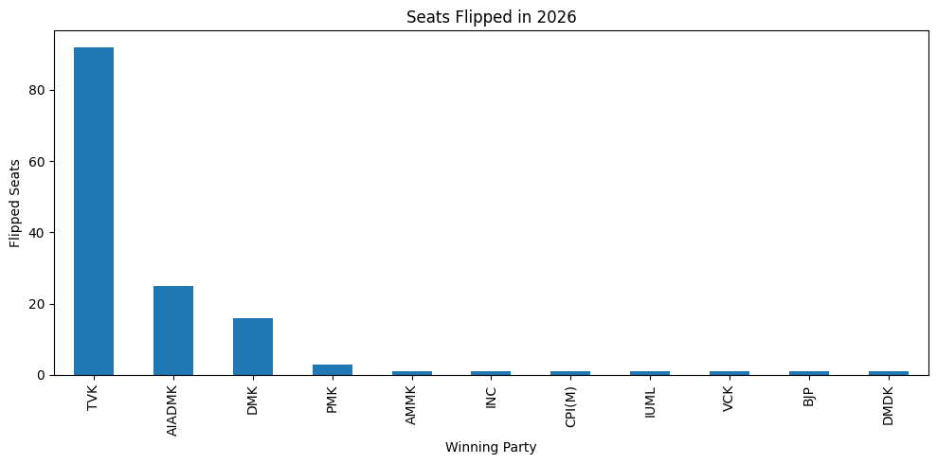
Seat Flip Analysis

Slide 6
Vote Share Analysis
Bar graph demonstrating the total number of votes won by prominent parties (for example, using vote_share after filtering for prominent parties).
Insight Boxes:
Prominent Parties: What parties have won the most votes and thus have large voter bases.
New Entrants: What parties have shown surprising strength even if they did not win many seats.
Political Diversity: How many parties won any votes at all.

Slide 7
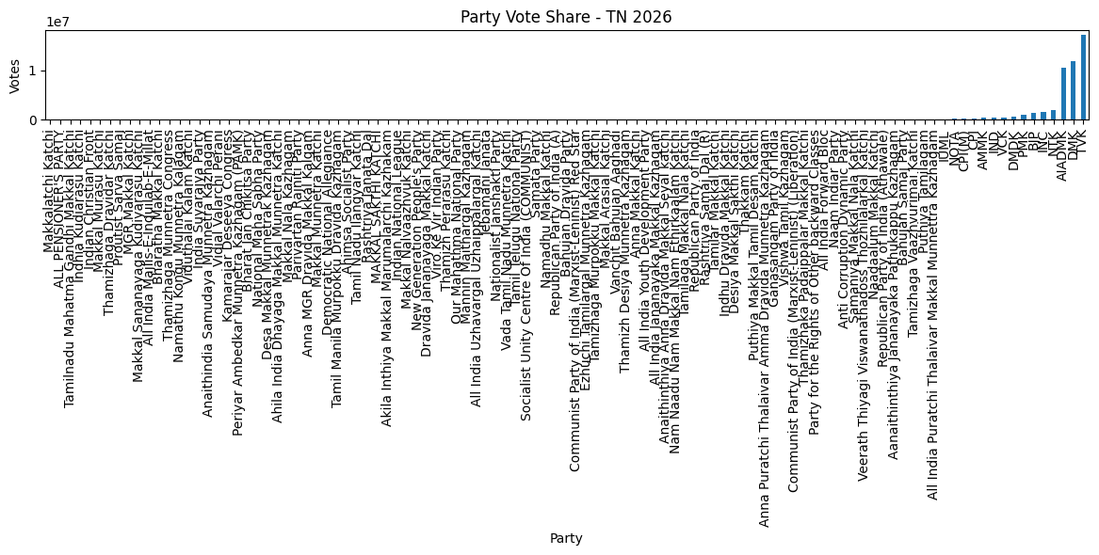
Vote Share Analysis

Slide 8
Margin Analysis
"There was one constituency that was won by just 1 vote." (Just an example, use actual margin in case it was 1, otherwise adjust accordingly).
Bar graph showing the smallest winning margins for certain constituencies (based on close_seats).
Insights:
A total of 26 races where margin was below 2000 votes.
Shows how competitive some constituencies can be.
Small margins highlight the significance of every vote.

Slide 9
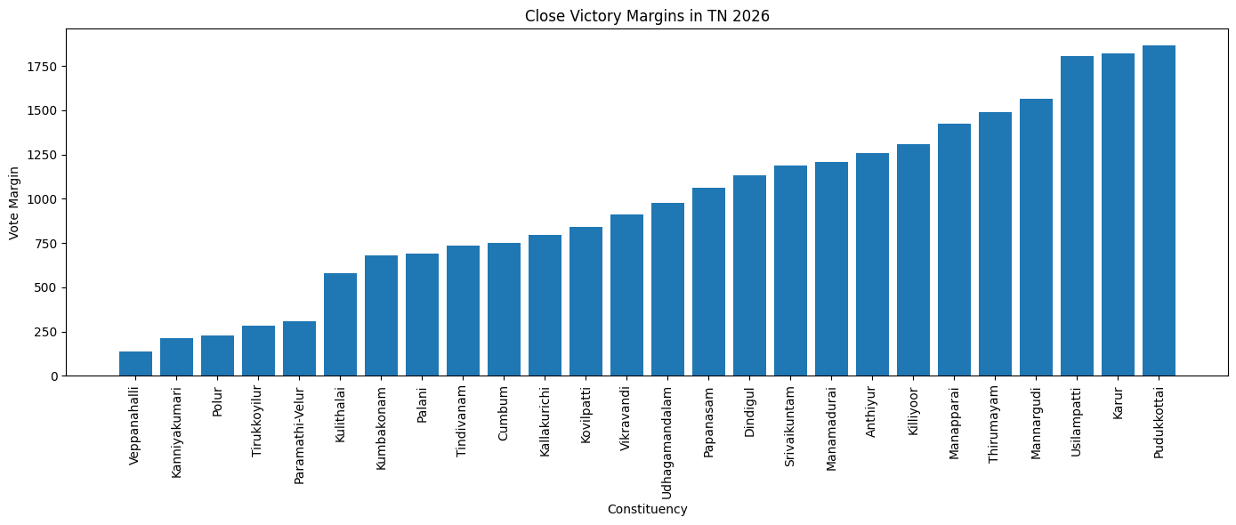
Margin Analysis

Slide 10
Interconnected Dynamics: Shaping the Election Outcome
Seat Flips and Voter Volatility
High number of seat flips suggests that voters are dynamic.
Voters are ready to change their allegiance depending on the changing political narrative and candidate performances.
Vote Reallocation
Change in vote shares of political parties is always directly proportional to winning or losing constituencies.
The emergence of new parties or the rise of an old one will definitely affect the political landscape.

Slide 11
Interconnected Dynamics: Shaping the Election Outcome
Small Margins and Strategic Significance
Small margins mean tough competition and can easily be turned around with a slight swing.
These constituencies are highly strategic and need to be prioritized by political parties.

Slide 12
Key Election Statistics
Total constituencies: 4257
Total close contests: 26
Closest margin: 138
Average margin: 16742.369098712446
Total flipped seats: 143

Slide 13
Analytical Workflow
Workflow Steps:
1. Data Collection: Sourcing election results (2021 & 2026) and constituency master data.
2. Data Cleaning & Preprocessing: Handling missing values, standardizing formats, and preparing data for analysis.
3. Analysis & Feature Engineering: Calculating margins, identifying winners, and determining seat flips.
4. Visualization: Creating charts to represent vote share, close contests, and flipped seats.
5. Insights & Interpretation: Deriving meaningful conclusions and answering research questions.

Slide 14
Key Takeaways
Tamil Nadu 2026 election is an example of the highly competitive and dynamic nature of politics.
There were many seat changes in several constituencies, reflecting a shift in voting trends.
An analysis of vote shares can shed light on the strength of dominant political parties as well as new political actors.
Small winning margins show the significance of local campaigning and each individual vote.

Slide 15
Thank You Email: chintalamaheshbabu1005@gmail.com

